Slide 1
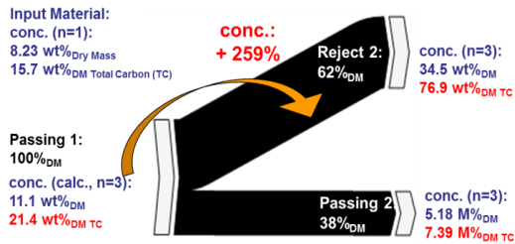
RENEWABLE ENERGY FROM WASTE Material-specific processing
Projektzeitraum:
Beginn:
(gepl.) Ende:
Auftraggeber/Förderer:
<<Name einfügen>>
<<Name einfügen>>
Projektpartner:
<<Name einfügen>>
<<Name einfügen>>
ProjektleiterIn:
<<Name einfügen>>
Projektteam:
<<Namen einfügen>>
<<Namen einfügen>>
<<Namen einfügen>>
<<Namen einfügen>>
Projektinformation
Hintergrund / Zielsetzung
Material und Methoden
Heterogeneous wastes are often used energetically as “refuse derived fuel” (RDF) substituting fossil fuels in certain industry sectors like the cement industry due to the EU emission trading scheme on CO₂.
The technical applicability of sensor-based sorting to split heterogeneous waste is evaluated in this work:
The material-specific absorption / reflection spectrum in the near infrared (NIR) range is used as separation criterion, in order to increased biogenic carbon content.
Heterogeneous wastes are often used energetically as “refuse derived fuel” (RDF) substituting fossil fuels in certain industry sectors like the cement industry due to the EU emission trading scheme on CO₂.
The technical applicability of sensor-based sorting to split heterogeneous waste is evaluated in this work:
The material-specific absorption / reflection spectrum in the near infrared (NIR) range is used as separation criterion, in order to increased biogenic carbon content.
Ergebnisse
Heterogeneous wastes are often used energetically as “refuse derived fuel” (RDF) substituting fossil fuels in certain industry sectors like the cement industry due to the EU emission trading scheme on CO₂.
The technical applicability of sensor-based sorting to split heterogeneous waste is evaluated in this work.
Abb. 1
Heterogeneous wastes are often used energetically as “refuse derived fuel” (RDF) substituting fossil fuels in certain industry sectors like the cement industry due to the EU emission trading scheme on CO₂.
The technical applicability of sensor-based sorting to split heterogeneous waste is evaluated in this work:
The material-specific absorption / reflection spectrum in the near infrared (NIR) range is used as separation criterion, in order to increased biogenic carbon content.
Literatur
Mötzl, H. (2009): Entsorgungswege der Baustoffe - ABC-Disposal - Anhang A2; Projektbericht im Rahmen der Programmlinie Haus der Zukunft, IBO –Österreichisches Institut für Baubiologie und –ökologie GmbH, Wien, Österreich
Baurestmassentrennverordnung (1991): Verordnung des Bundesministers für Umwelt, Jugend und Familie über die Trennung von bei Bautätigkeiten anfallenden Materialien, BGBl. Nr. 259/19911
Kontakt
N.N.
Telefon:
+43 (0)3357/45370 E-Mail:
forschung@fh-burgenland.at

