Slide 1
We combine TOPICS & DIVERSITY.
We combine TEAM SPIRIT & SUCCESS.
We unite PEOPLE.

Slide 2




Fachhochschule
Burgenland
Forschung
Burgenland
FH Burgenland
Weiterbildung
Vorbereitungslehrgang
Advanced Bridging Programme
PhD Programme
Akademie Burgenland
alumni FH Burgenland

Slide 3
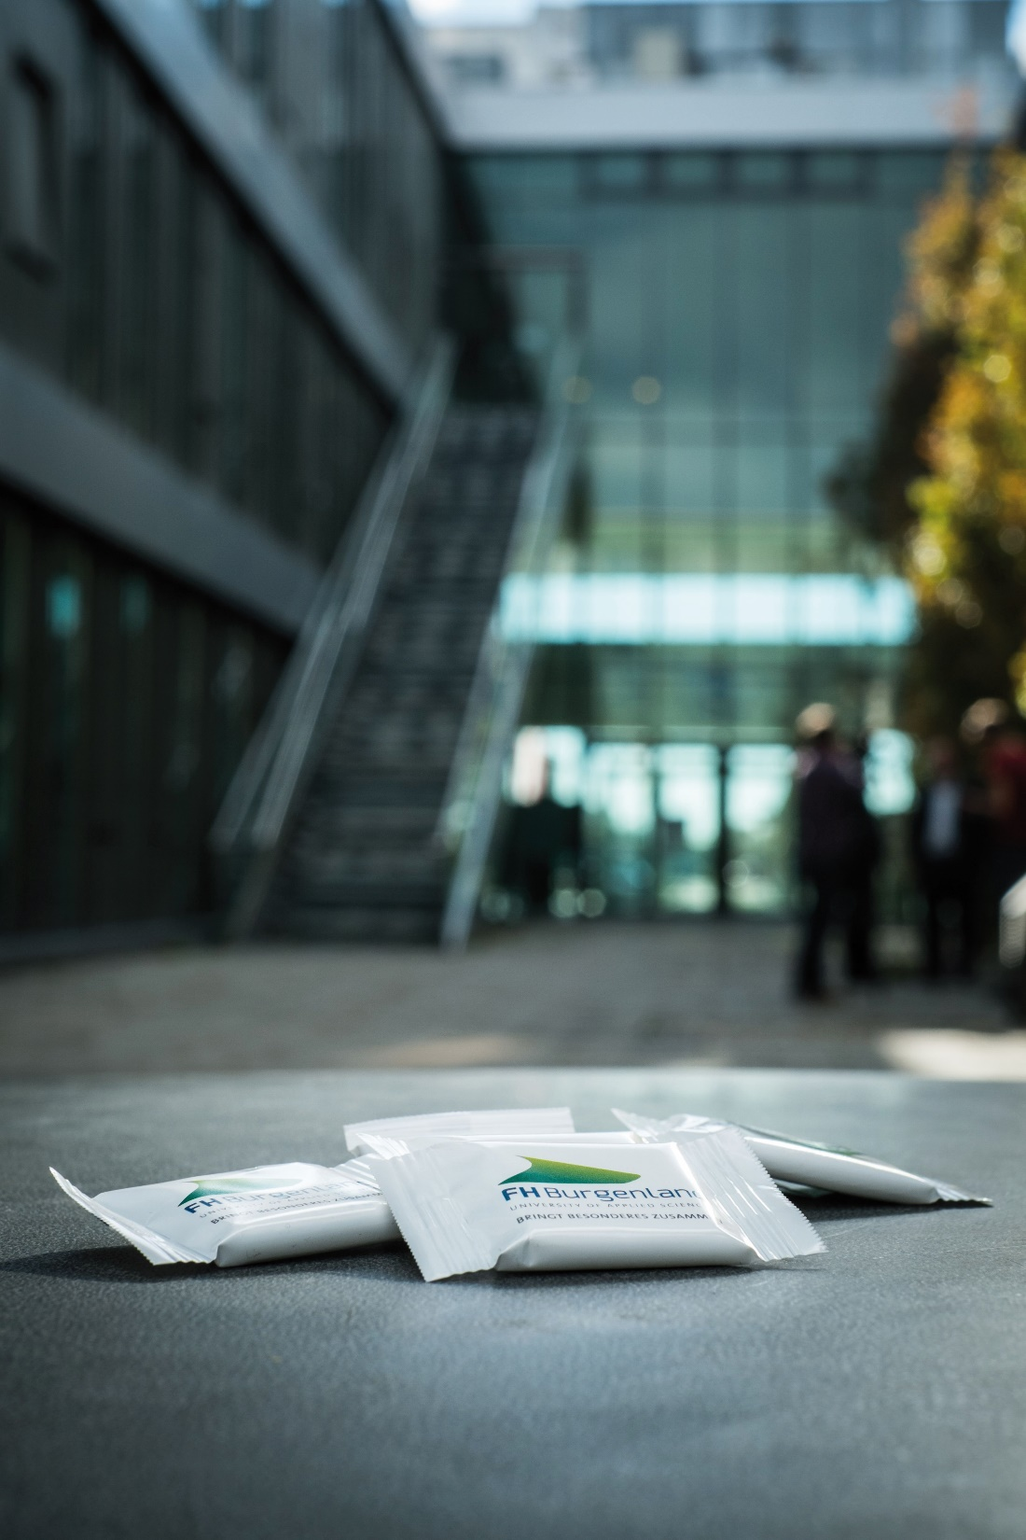
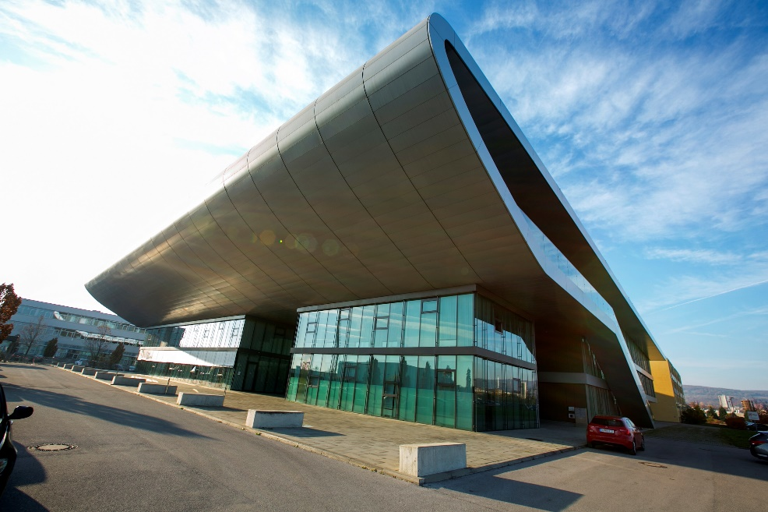
Campus Eisenstadt
Our locations
Campus Pinkafeld
additional training location
Jormannsdorf

Slide 4
FH Burgenland in figures
290
670
400
employees
lecturers
business partners

Slide 5

FH Burgenland in figures
2600
1000
>12000
students
beginners of studies
graduates

Slide 6
FH Burgenland in figures
13
13
2
Bachelor‘s degree programmes
Master‘s degree programmes
PhD programmes

Slide 7
26 study programmes
+ 45 continuing education courses/PhD
Overview. 2023
International
Wine Marketing
E-Learning and
Knowledge Management
International
Business Relations
Digital Media and
Communication
Sustainable Energy Systems
PhD-Programme in
Int. Economic Relations
and Management
Human Resource
Management and
Labour Law
Cloud Computing
Engineering
Building Technology and
Management
Health Management and
Integrated Healthcare
PhD-Programme in
Educational &
Communication Sciences
European Studies –
Management of EU Projects
Business Process
Engineering & Management
Energy and Environmental
Management
Health Promotion and
Human Resource Management
Master’s courses and Expert courses
in academic continuing education
(especially MBA)
Physiotherapy
Logopaedics*
Midwives
Software Engineering
Building and Energy Technology
Health Care and Nursing
International
Business Relations
IT Infrastructure-
Management
Energy and Environmental
Management
Health Management and
Health Promotion
(Advanced)
Bridging
Programme
International
Sustainable Business
Information, Media &
Communication
Social Work
Applied Electronics
and Photonics
Ergotherapy*
Center for Preparatory Courses
fulltime parttime
* starting autumn 2024, subject to the approval by AQ Austria.

Slide 8

We unite NEAR & FAR

Slide 9

19 Countries in the EU
Bosnia-Herzegovina
Switzerland
Russia
90 Partner Institutions

Slide 10

We combine PRACTICE & ORIENTATION

Slide 11





















Slide 12
BACHELOR‘S DEGREE
Applications until March 31st
MASTER‘S DEGREE
Applications until May 31st
PHD PROGRAMMES
Applications until 30th June
INFODAY
at Eisenstadt or Pinkafeld
1st December 2023, 2p.m. – 7 p.m.
INFODAY
at Eisenstadt or Pinkafeld
16th March 2024, 9a.m. – 2 p.m.
INFOLINE
+43 (0)5 7705 3500
www.fh-burgenland.at

